Slide 1
Waves and Music
Virata Pusuluri, Krishna Pusuluri, Sunitha Basodi
Grade 1, Nirmala Vishwa Vidya Peetham (Home School), Dunwoody GA
(Dekalb County)

Slide 2
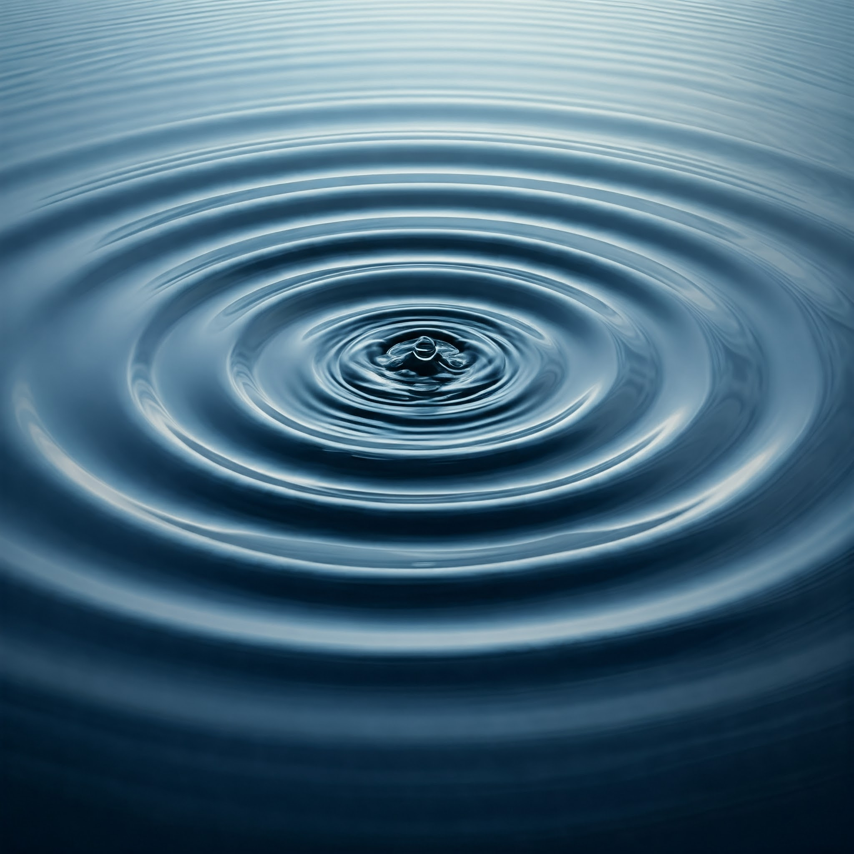
Waves properties and music
A wave is a disturbance that keeps moving up and down, or left and right in a systematic way, just like when we drop a stone in water.
We use Python programming to study wave properties like wavelength (λ), frequency (𝛎), amplitude (A), velocity (V) and attenuation factor (f).
We check how these wave properties control musical sounds on a flute or a piano.

Slide 3
Properties of waves
Amplitude (A)
Frequency (𝛎)
Wavelength (λ)
Velocity (V)
Attenuation factor (f)

Slide 4
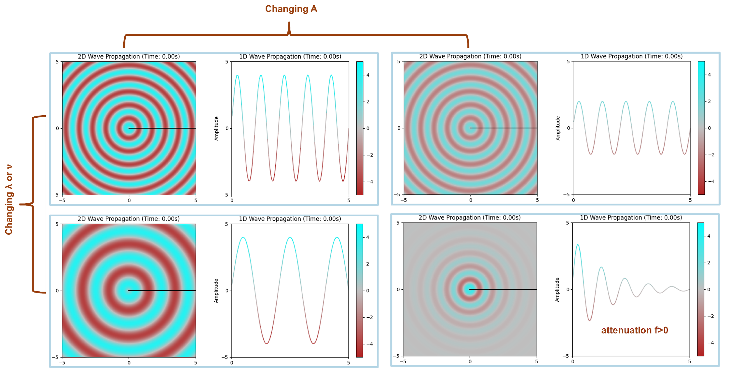
Changing wave properties
We observe the following when we change the wave properties λ/𝛎, A, and f while keeping V fixed.

Slide 5
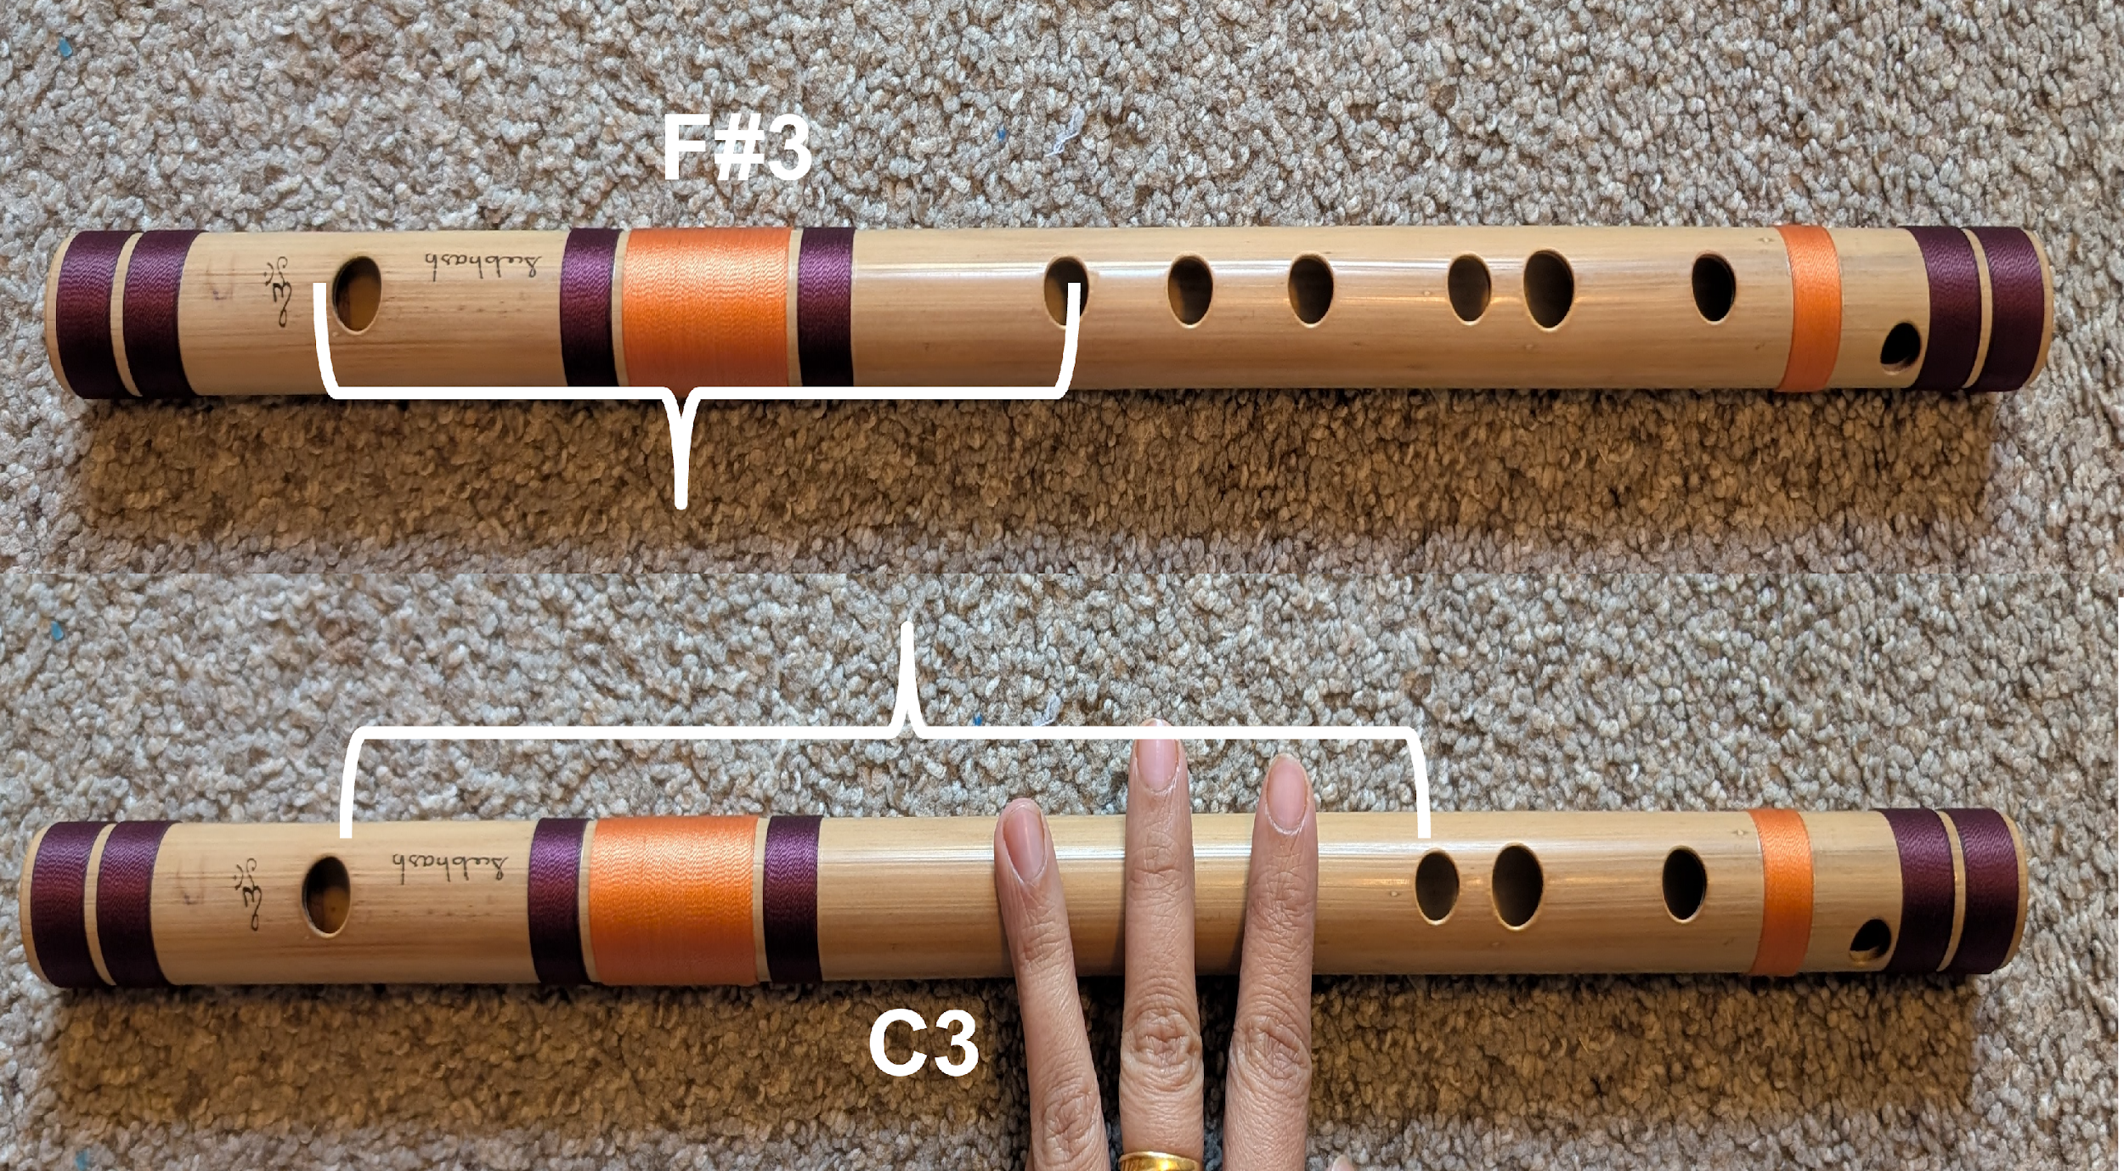
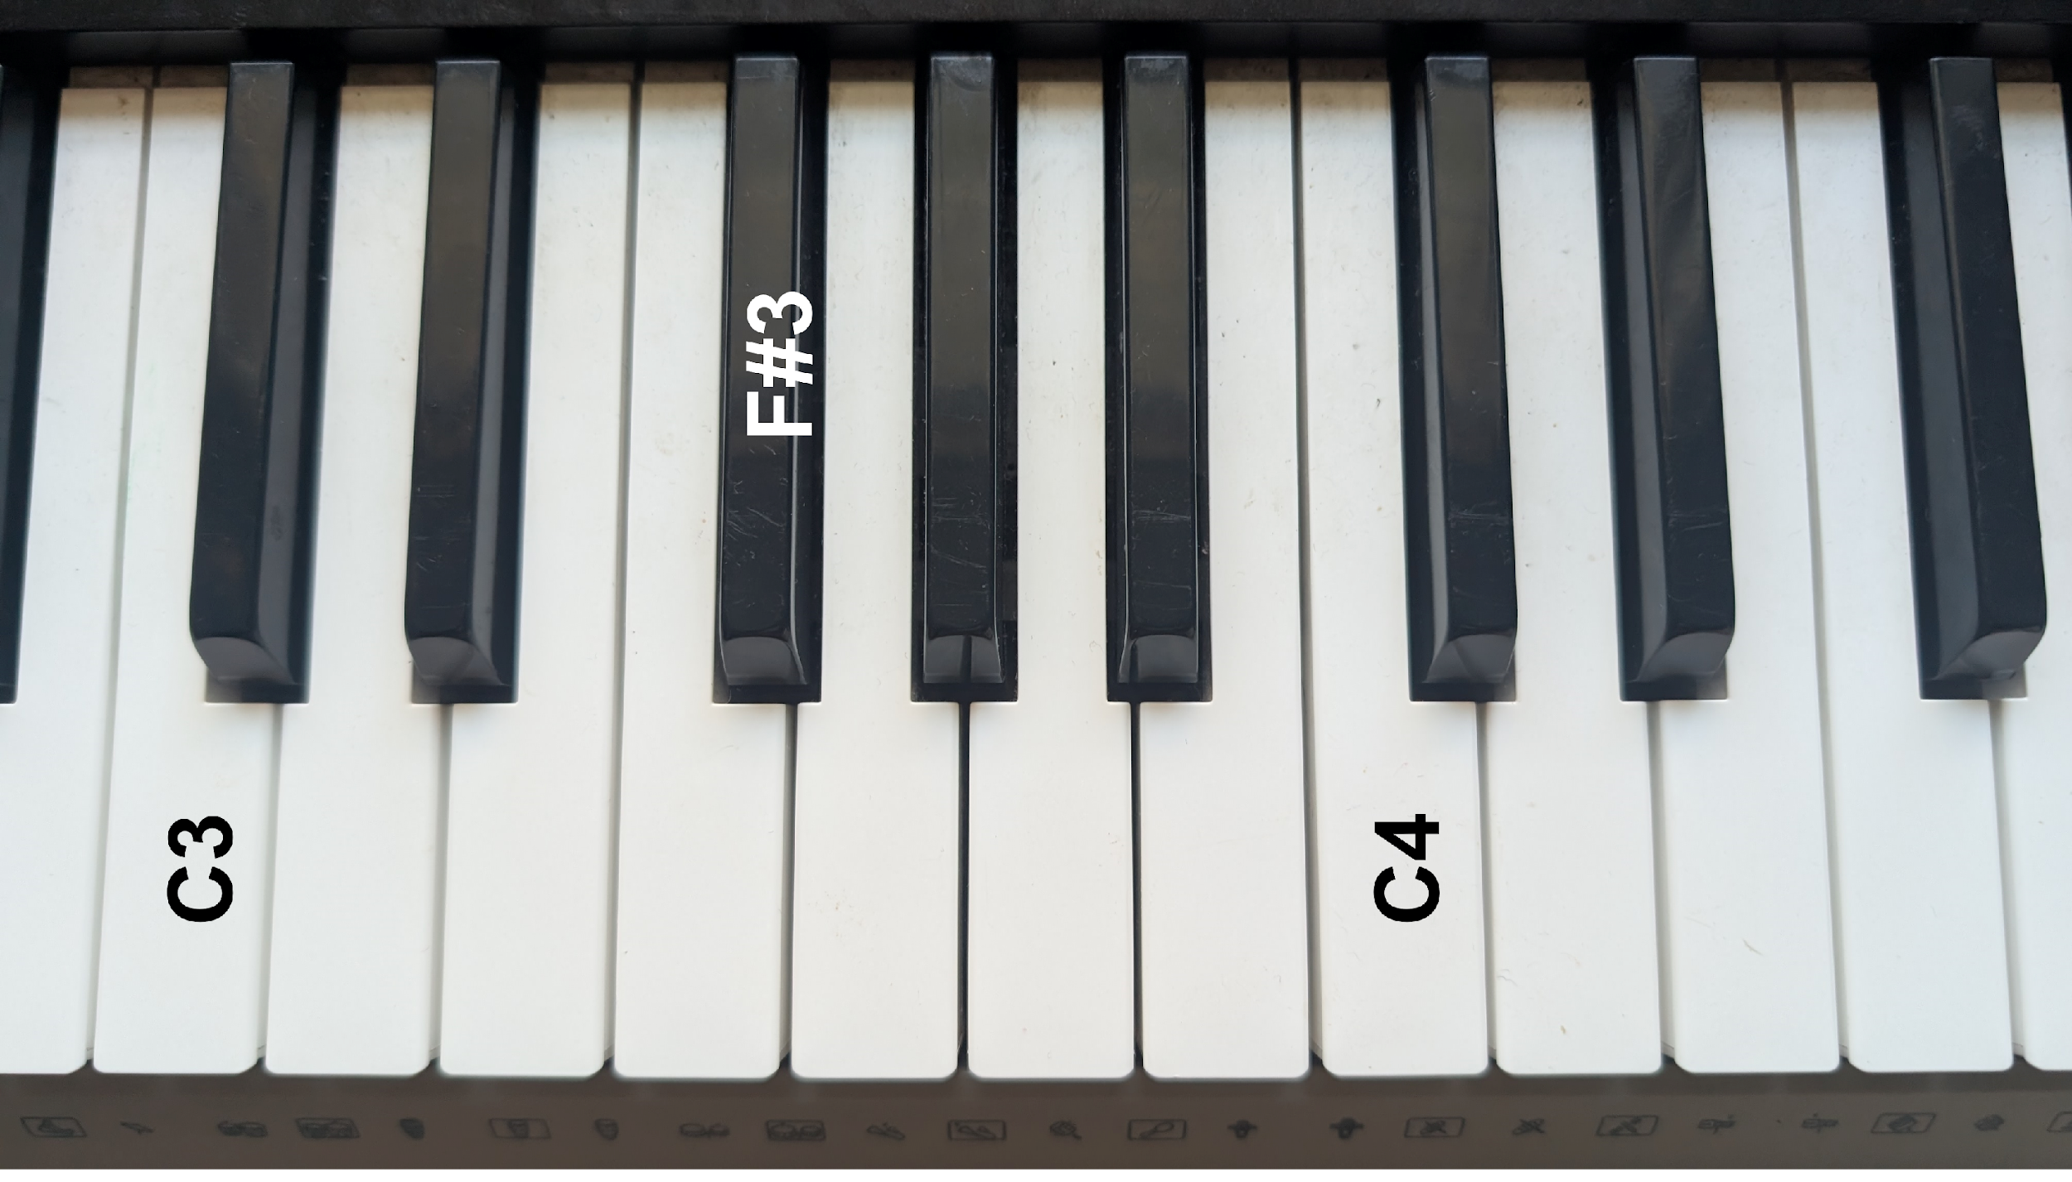
Wave properties in musicsal instruments
On a flute/piano, wave property λ decreases and 𝛎 increases as we move from the note C3 to a higher note F#3. ‘A’ controls volume, ‘V’ doesn’t change for sound in air, ‘f’ is higher for piano than harmonium.

Slide 6
Methods
We used Python libraries and Google Gemini AI to create functions to plot waves and play Indian Carnatic music songs based on musical notes.
def create2D1DWaves( wavePropertiesAsParameters )
…
return
def playMusicFromNotes(musicalNotesAsParameters )
…
return

Slide 7
Scientific Method
Question?
Wave properties and musical sounds
Experiment and Data Collection?
Modeling with python
Hypothesis?
Changing wave properties (λ, 𝛎 , f and A) change musical sounds
Testing?
Flute, piano, python
Conclusion?
𝛎/λ change musical notes, A changes volume, f is higher for piano and lower for harmonium

Slide 8
References
Question?
Wave properties and musical sounds
Experiment and Data Collection?
Modeling with python
Hypothesis?
Changing wave properties (λ, 𝛎 , f and A) change musical sounds
Testing?
Flute, piano, python
Conclusion?
𝛎/λ change musical notes, A changes volume, f is higher for piano and lower for harmonium

Slide 9
PyCharm https://www.jetbrains.com/pycharm/
Google Gemini AI https://gemini.google.com/
OpenStax Physics https://openstax.org/details/books/physics
References

